Slide 1

Kimzee Food
Presented by: Debadrita

Slide 2

Product
Vision
Who does not like cooking and want to save time.KimzeeFood is a meal ordering platform that provides monthly meal subscription plans unlike instant food ordering platforms our product provides customiable monthly meal subscription plans curated according to the users need.

Slide 3

KminzeeFood
User Personas
Learn about what matters to our users and how they can have a better experience using our platform.

Slide 4
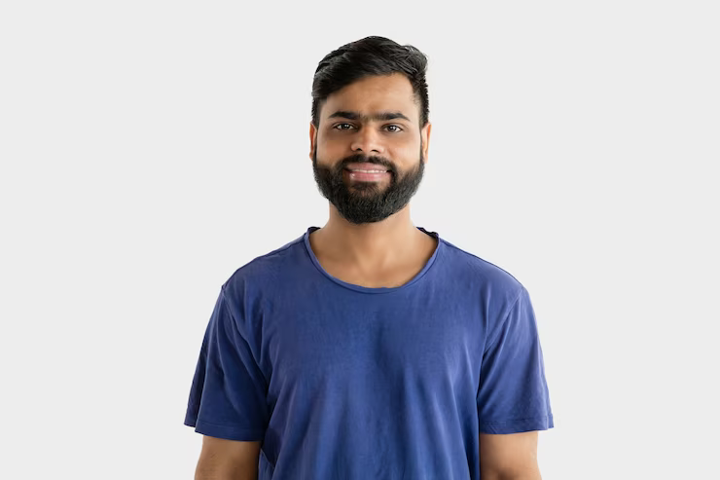
About the User
Dev is a confident full-time designer who likes to stay on top of his customers' needs. During his free time, he engages in some side hustles and recreational activities.
Problems
Find it hard to take out time for weekly/monthly grocery shopping
Don't like cooking and not want to spend on what he doesn't like to do instead spend that on recreational activities.
Name | Dev
Age | 24 years old
Occupation | Designer
Location | Bangalore
Income Range: | Rs. 8 LPA
Personality
Imaginative
Enthusiastic
Social
Flexible
Self discipline
Goals and Needs
To widen his creative repertoire
To provide relevant and engaging designs for his customers

Slide 5
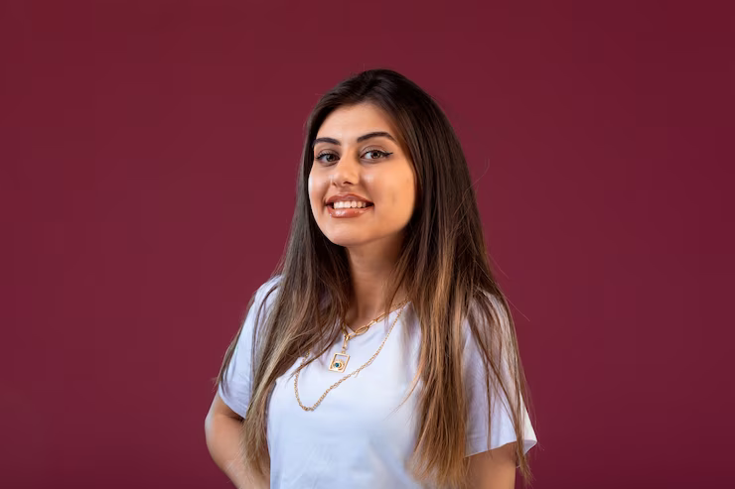
About the User
Sakshi is a full-time student who likes to stay on top of her studies. She aims to grow her subject skills and in her carrier
Problems
Cooking for herself takes up significant amount of her time, which she can use to focus on her studies.
Ordering out frequently is expensive for her student budget.
Name | Sakshi
Age | 19 years old
Occupation | Student
Location | Delhi
Income Range: | Pocket money of Rs. 12k/ month
Personality
Hardworking
Carrier oriented
Health consicious
Goals and Needs
Cheap monthly meal plans.
she doesn't have to cook and focus her saved up time on other self building activities.

Slide 6
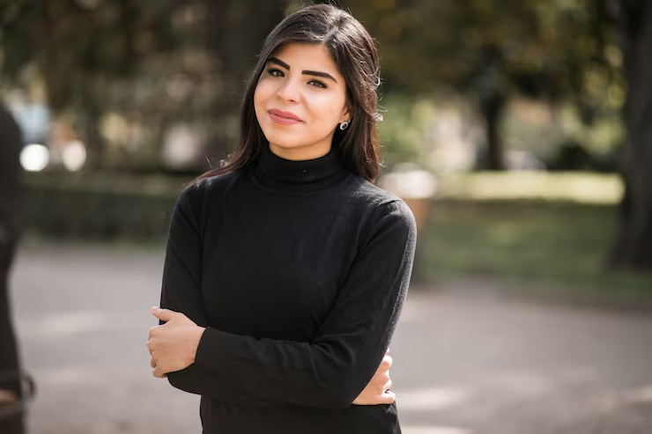
About the User
Yaashi is a college student staying in off campus housing (Paying guest). she travels 1 hour daily to her college.
Problems
The food provided at her off campus housing is not good and of low quality.
She misses her home style food cooked back at her home.
Name | Yaashi
Age | 20 years old
Occupation | Student
Location | Delhi
Income Range: | Pocket money of Rs. 15k/ month
Personality
Foodie
Goals and Needs
Home style cooked food delivered at her place of stay .
Good quality food available at affordable prices.

Slide 7
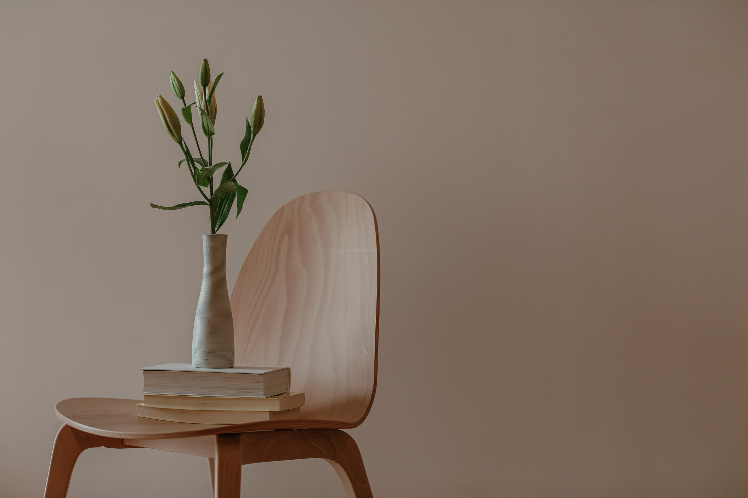
SNAPSHOTS OF WEBSITE

Slide 8
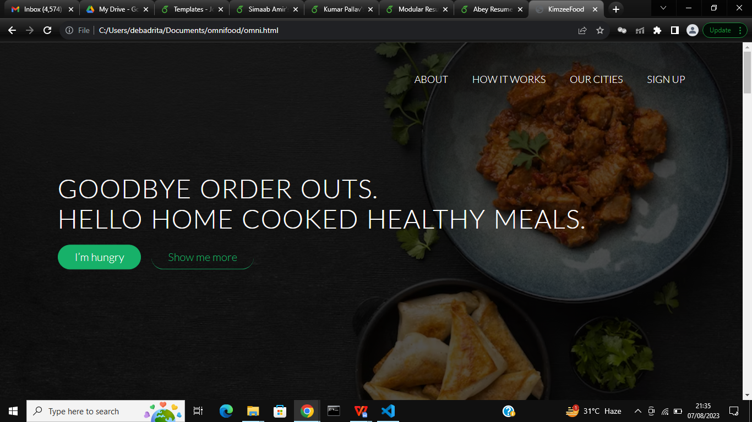

Slide 9
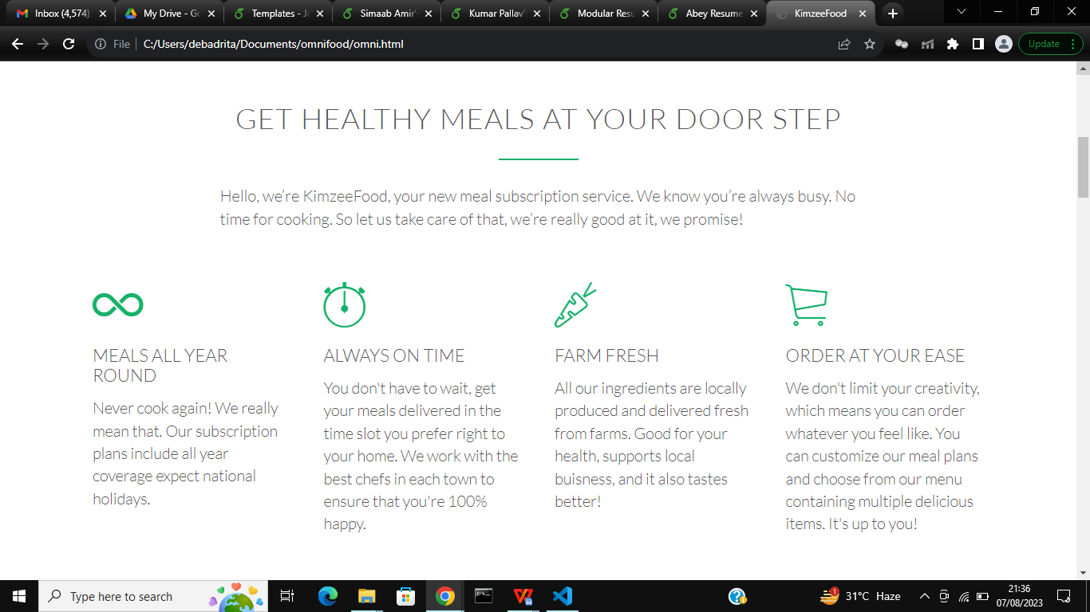

Slide 10
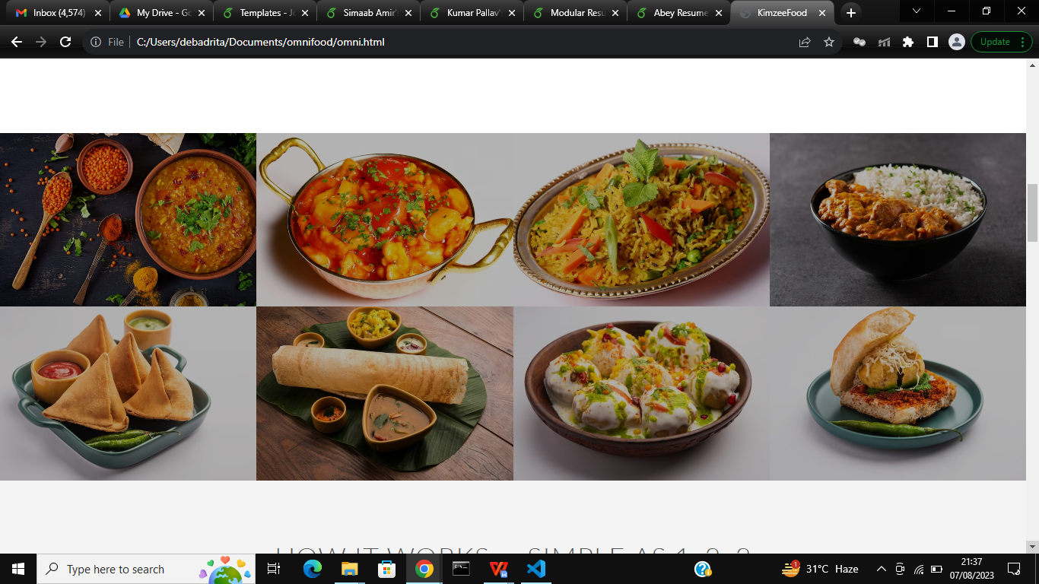

Slide 11
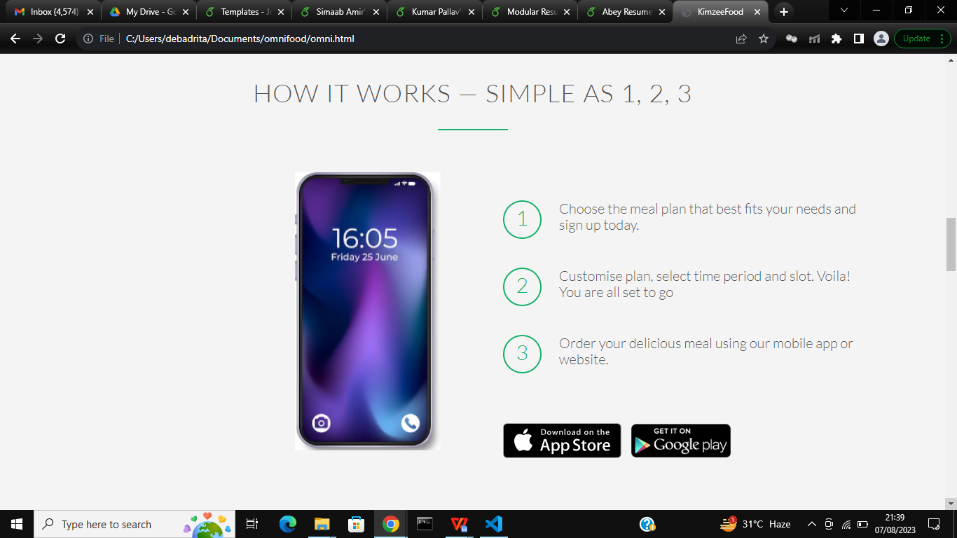

Slide 12
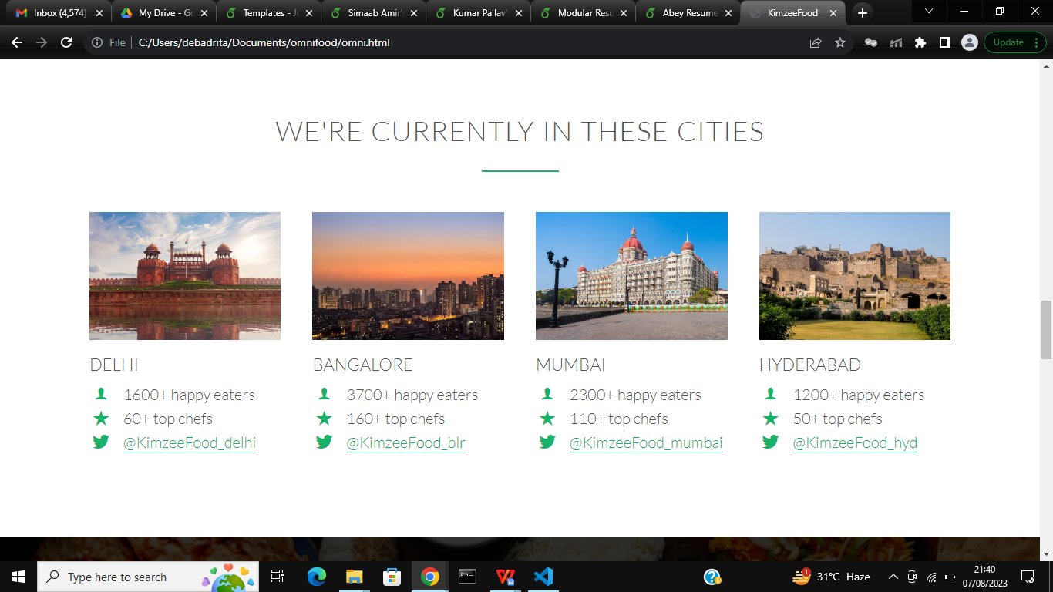

Slide 13
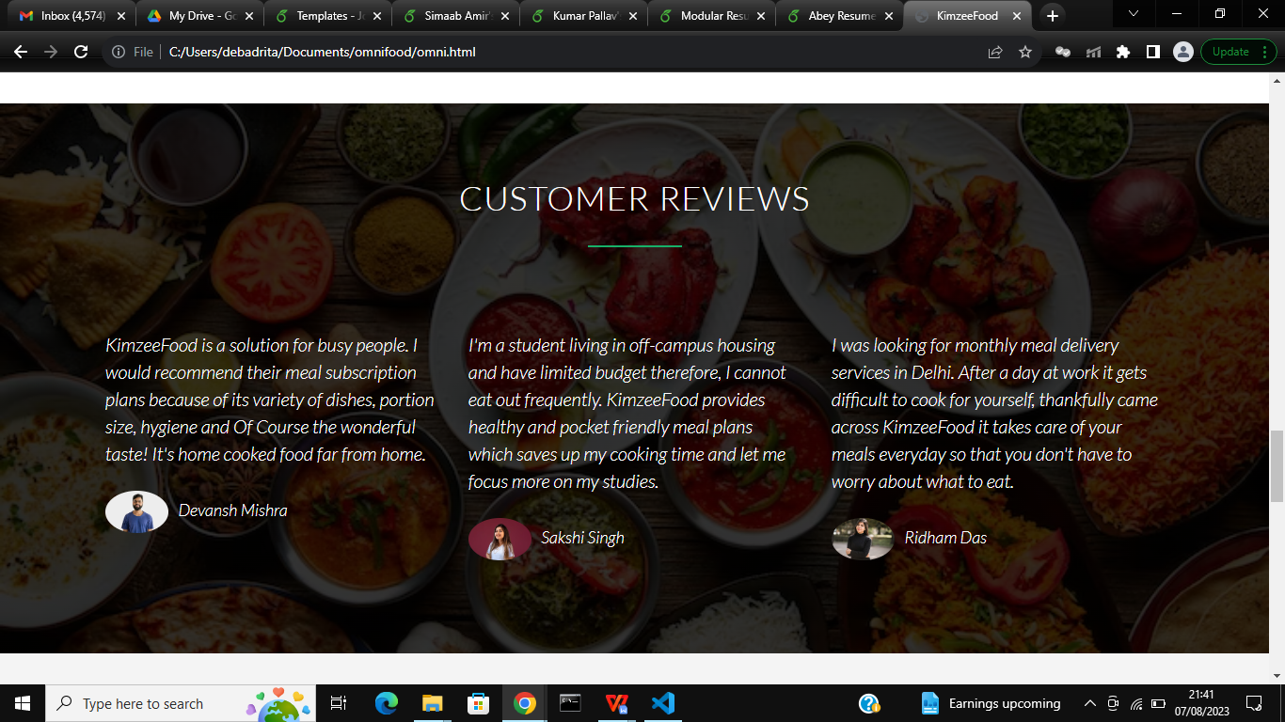

Slide 14
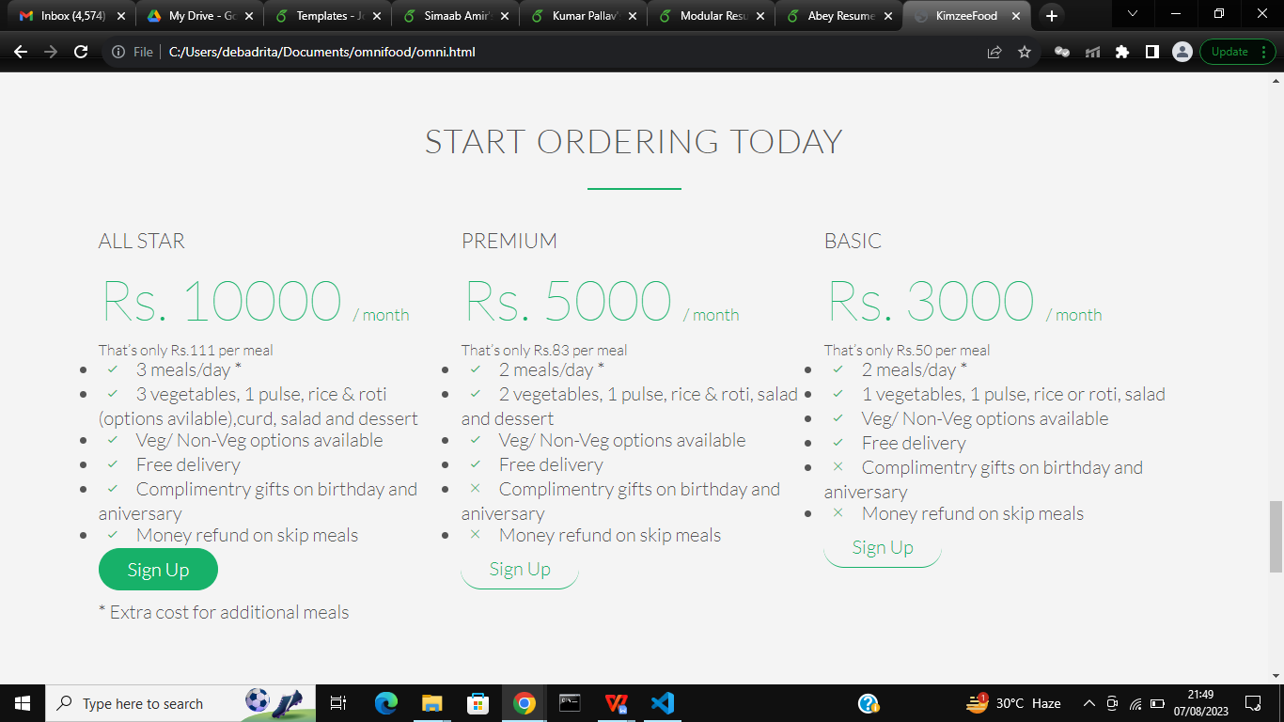

Slide 15

Thank You

